Slide 1
A DAY IN THE LIFE OF A
FREESTOCK ITEM
LAWRENCE FERBEE’S
FIRST POWERPOINT

Slide 2
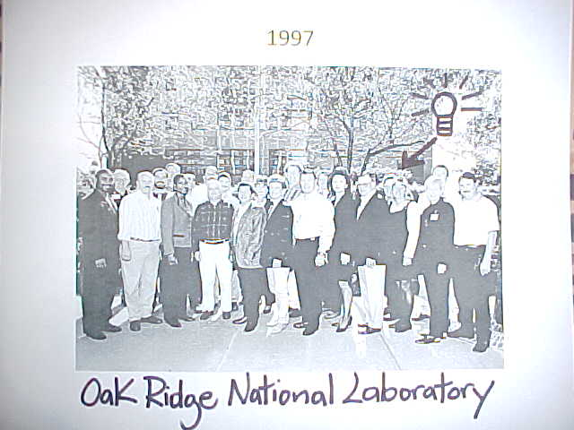
The Start Of It All
Notes:
Ideal came from a visit to Oak Ridge’s Second Hand Store.

Slide 3
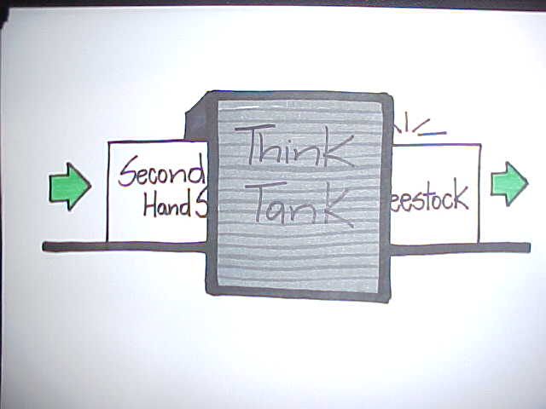

Slide 4
Non Used Incoming Items
Office supplies
Wire and Cable
Electronics
Hardware
Furniture
Notes:
Ideal came from the ‘97 MMW (Oakridge) Second Hand Store.

Slide 5
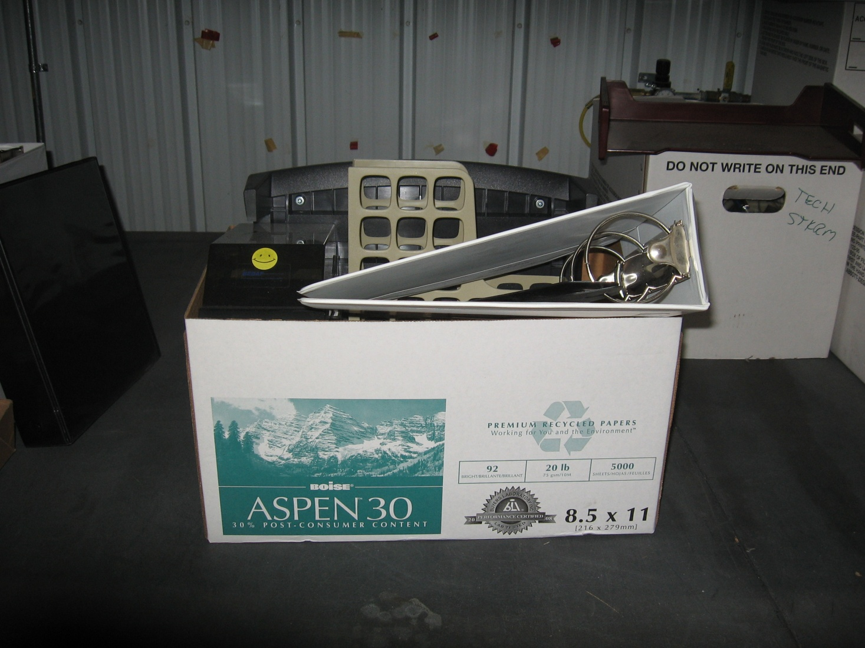
Homeless Items

Slide 6
Research For Each Item
Description
Dollar Value
Quantity
Group and Stock Number
Notes:
Description and dollar value are based from catalog and on line search. Dollar value are for “our eyes only”. Dollar value is used for reporting. When adding furniture, a picture is used in description.

Slide 7
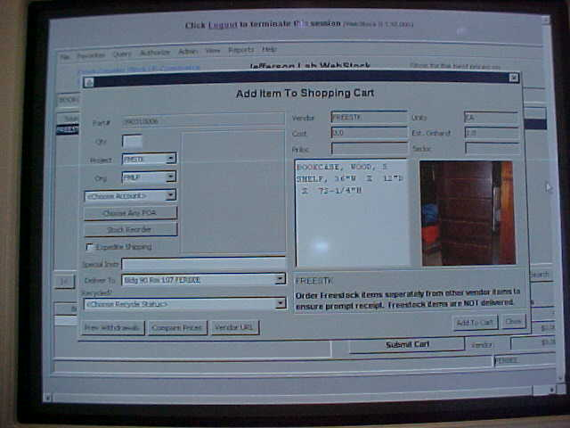
Notes:
Furniture is the only items with pictures

Slide 8
FreeStock Area
Building 90 (in stockroom)
Building 36

Slide 9
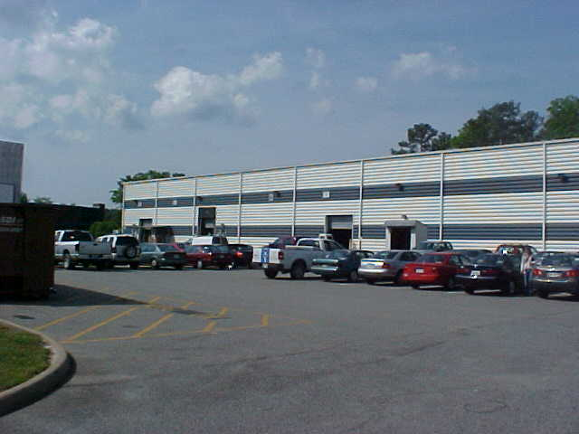
Building 90 (FreeStock)

Slide 10
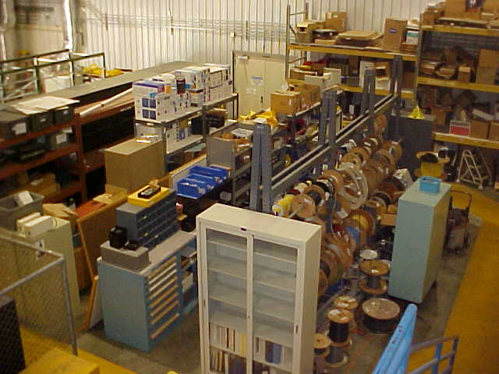
FreeStock: Building 90

Slide 11
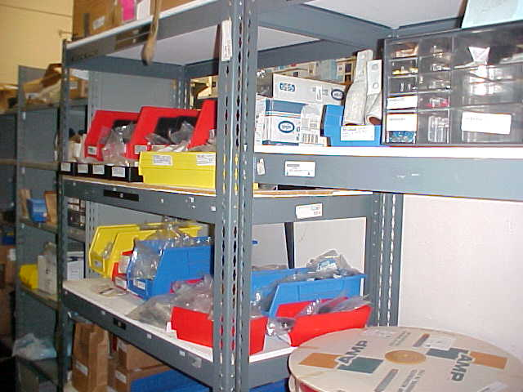
Notes:
See the labels.

Slide 12
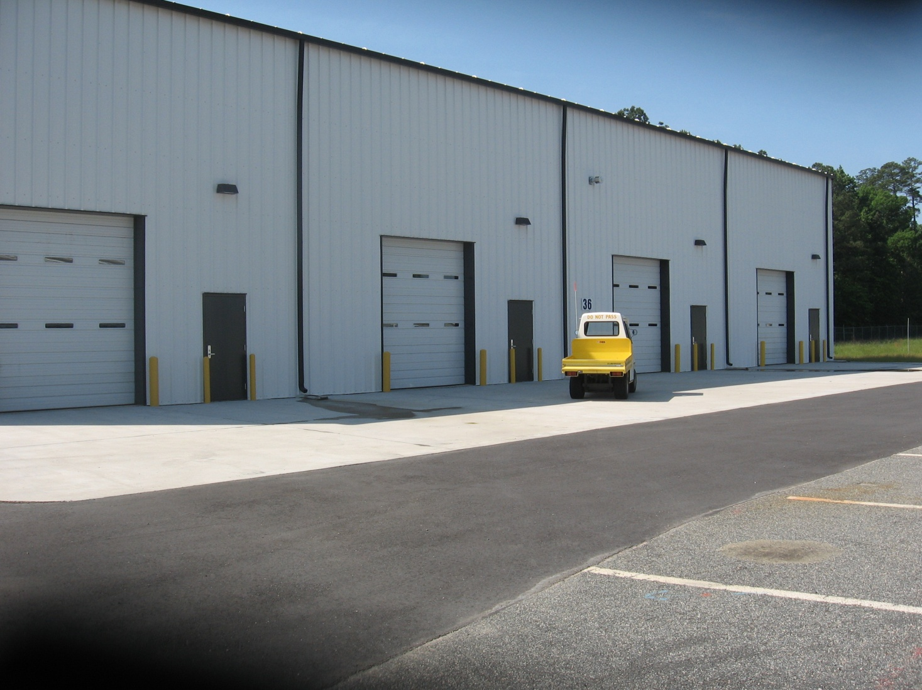
Building 36 (Furniture)
Notes:
Location ….near the south access building (#38)…building was open in Oct.

Slide 13
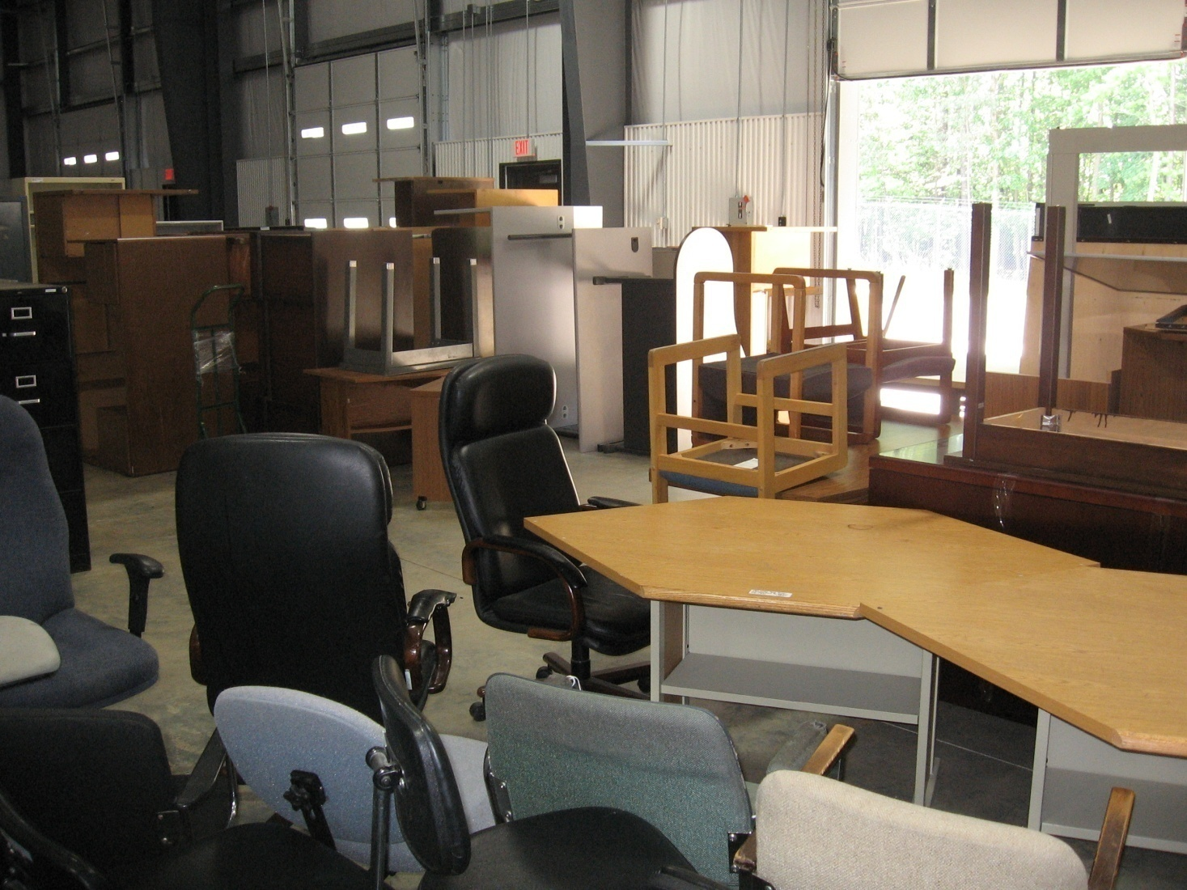

Slide 14
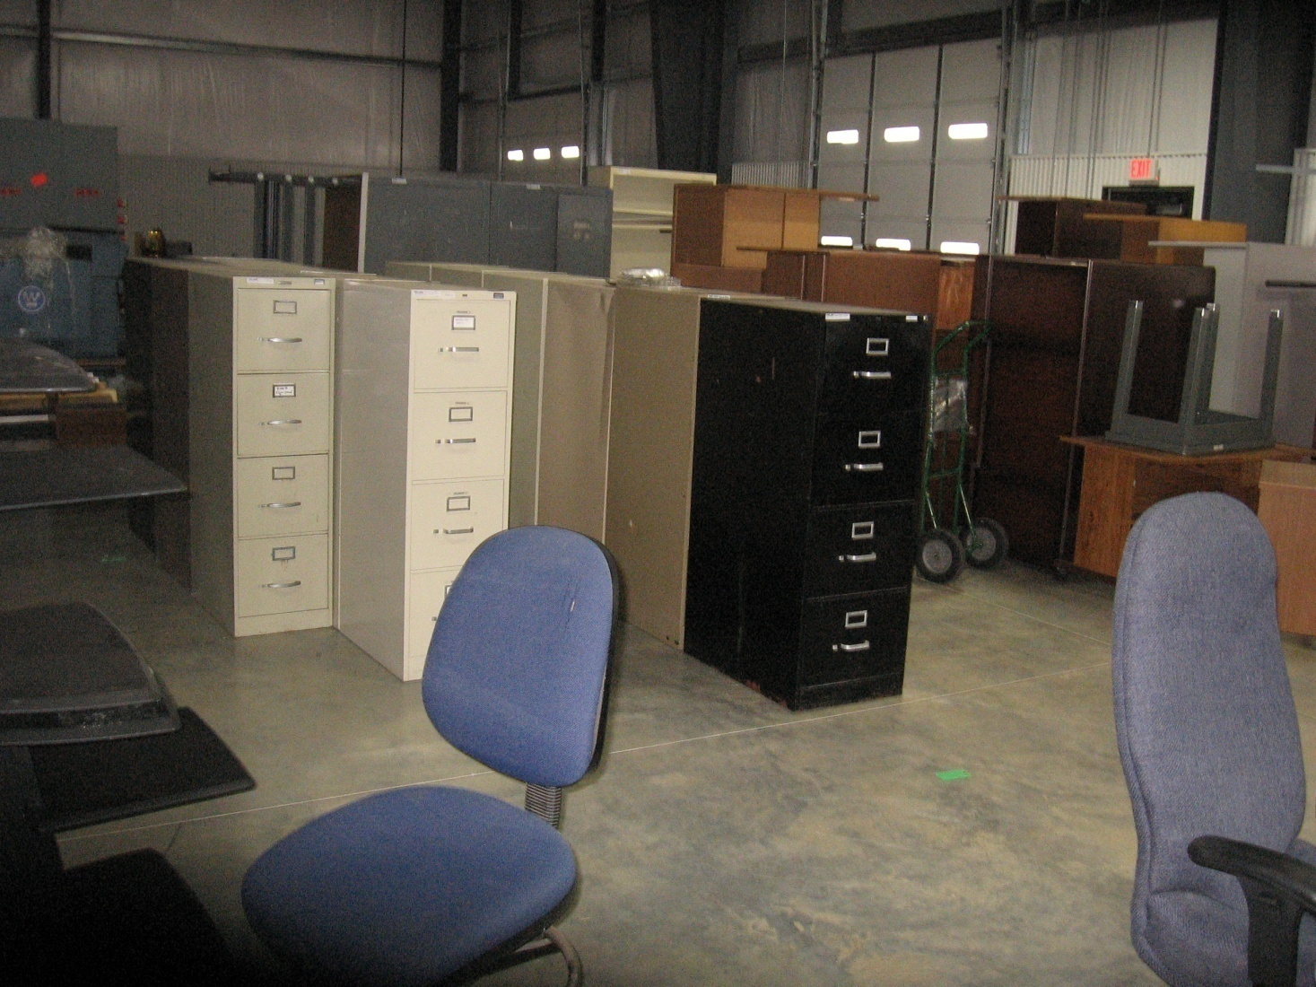

Slide 15
FreeStock Do’s And Don’ts
Do, Feel Free To Browse
Don’t, Help Yourself
Do, Fill Out The Withdraw Sheet
Don’t, Assume We Deliver
Do, Give Us Your Unused
Don’t, Give Us Nasty, Rusty, Filthy Items

Slide 16
Ways Of Using The FreeStock
On Line Via Webstock
In Person
Notes:
Web Stock note….freestock is included with the other lines of vendors. Webstock prints out the order, while in person fills out sheet.

Slide 17
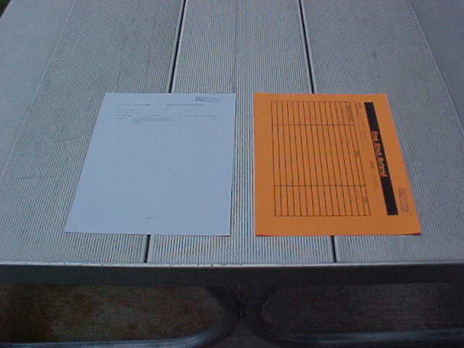
This Or That ?

Slide 18
Then And Now
Notes:
2005-2006($382.56) 2006-2007($8,298.37) 2007-2008($17,444.30) 2008-2009($40,344.93)

Slide 19
FreeStock Objective Met
Reuse Non-used Item
Cut The Cost Of Spending
Add Value To The Lab
“Momentary Shine”
Great Word Of Mouth

